Slide 1

OpenAgile Overview

Slide 2
OpenAgile Overview
What is OpenAgile?
A method for organizations, teams and individuals to...
Increase Productivity and Quality
Allow Innovation and Respond to Change
Increase Team Spirit and Personal Engagement
Create a Culture of Continuous Improvement
Reduce Costs and Risk
✔

Slide 3
OpenAgile Overview
What is OpenAgile?
OpenAgile
is a
Value Delivery System &
Learning System &
Learning Community

Slide 4
OpenAgile Overview
What is OpenAgile?
Purpose of OpenAgile
is:
To create an environment in which people are free to express their true nature and capacities to contribute to the betterment of their organization.

Slide 5

OpenAgile
Foundations
OpenAgile
requires
Truthfulness
honesty, integrity, transparency, self-awareness

Slide 6
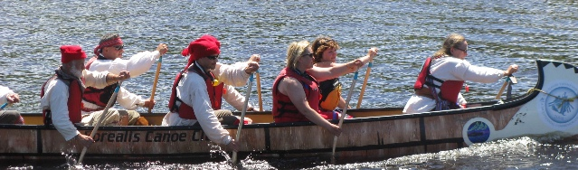
OpenAgile
Foundations
OpenAgile
requires
Consultative Decision-Making
freedom to speak, search for truth, unified action

Slide 7
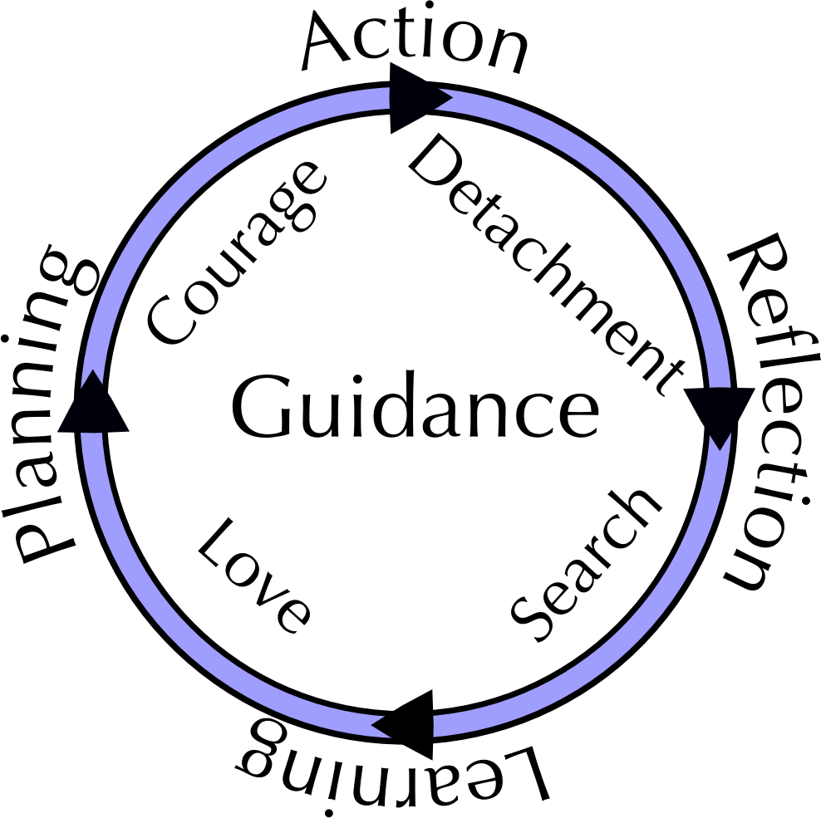
OpenAgile
Foundations
OpenAgile
requires
Systematic Learning

Slide 8
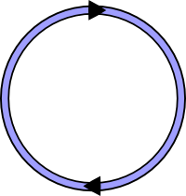
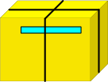
OpenAgile Overview
The Big Picture
Cycle 1
GOAL
Work towards a clear goal or purpose.
Break up the work into short Cycles.
Deliver valuable results at the end of every Cycle.
Notes:
- every iteration the same length
- complete deliverable
- no ups and downs for staffing or effort

Slide 9

OpenAgile Overview
The Big Picture
Cycle 1
Cycle 2
Cycle 3
Cycle 4
GOAL
Each Cycle builds on the results of previous Cycles and every
Cycle is the same length of time.
(For projects there should be at least five Cycles from start to finish
to allow for suitable amounts of feedback and learning.)
Notes:
- every iteration the same length
- complete deliverable
- no ups and downs for staffing or effort

Slide 10
OpenAgile Overview
Value Drivers
Value Drivers are the things you work on during a Cycle and which you need to do to deliver value towards the Goal
Value Drivers are prioritized into a list, usually with highest value at the top
The list of Prioritized Value Drivers is used at the start of each Cycle to determine what activities occur during the Cycle
A single Value Driver may be started and finished in one Cycle, take multiple cycles to complete, or be indefinite in duration
$$$$
$$
$
Notes:
Simultaneous work is one of the biggest mindset challenges... however, only discuss this if it is brought up by someone in the class. It will be covered in the Iterations module.

Slide 11

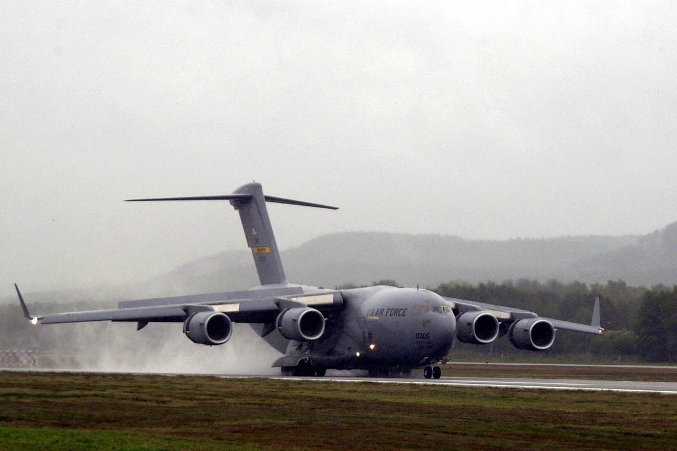
OpenAgile Overview
Organic Growth
vs.
- not an airplane until it is “finished”
- built according to detailed plan
- built in stages
- more fragile as it ages
- always a tree
- adapts as it grows
- seasons are its Cycles
- stronger as it ages
Each Value Driver is like a ring of growth on a tree... not a part of an airplane

Slide 12
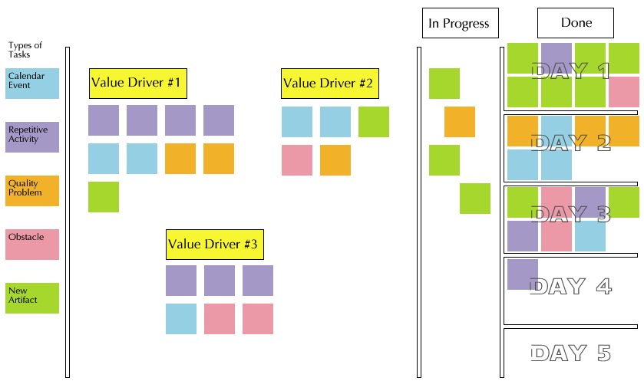
OpenAgile Overview
The Cycle Plan
Teams should make their Cycle Plan visible. Displaying Value Drivers and Tasks on a wall is a good way to do this:

Slide 13
OpenAgile Overview
Roles and Paths of Service
Team Member:
Performs work, committed to the goal, and creates value for stakeholders
Paths of Service:
Ways that Team Members can help the team become more effective
    Growth Facilitation: Team Member(s) who promote organic growth and
    the skills to work this way
    Process Facilitation: Team Member(s) who facilitate the application of OpenAgile foundations and practices
Stakeholders /
Customers /
Sponsors
Team
GF
PF

Slide 14
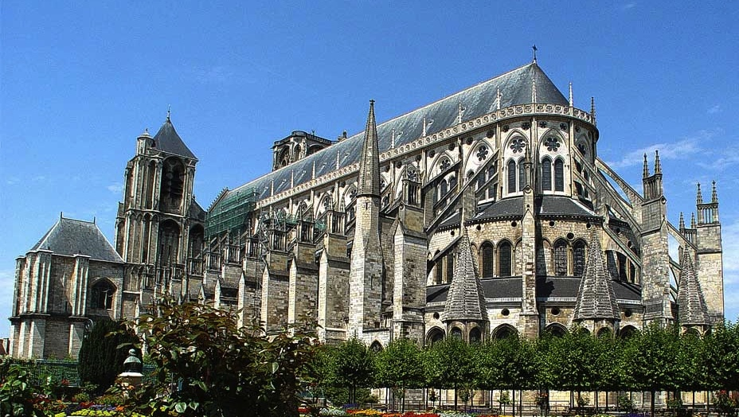
OpenAgile Overview
Team Self-Organization
Team Members are committed to the overall goal!
Not stone-cutters
Not wage-earners
Cathedral builders!

Slide 15
OpenAgile Overview
Team Self-Organization
Team Members communicate about work throughout the Cycle!
Cycle Plan
Task
Task
Task
Task
Task
Task
Blah blah blah blah!!!!
I like peanuts and celery.
How many tasks did you do?
Don't be shy!!!!
Task
Task
Task
Task
Task

Slide 16
OpenAgile Overview
Team Self-Organization
Team Members volunteer for Tasks as the Cycle progresses!
Sometimes a Task is a
natural fit for a particular
Team Member.
Cycle Plan
Task
Task
Task
Task
Task
Task
Task
Task
Task
Task
Task
Task
Task
Task

Slide 17
OpenAgile Overview
Delivering Value
For Projects:
Avoid risky bet-the-business efforts
Deliver value continuously
Traditional end-of-project delivery
Stop Here!
Incremental Value Delivered
$
$
$
Preparation
$
$
$
Minimum Return
Cost of Team
Time (1 tick mark = 1 Cycle)

Slide 18
OpenAgile Overview
Delivering Value
For Operations:
Avoid increasing bureaucratic overhead (waste)
Deliver better value, more efficiently
$
Cost of Operations
Incremental Value Delivered
$
$
$
$
Time (1 tick mark = 1 Cycle)

Slide 19

OpenAgile Overview
Learning
Don't get stuck in bad behaviors and sub-optimal processes
Continuous improvement of:
  Results
  Process
  People

Slide 20
OpenAgile Overview
OpenAgile Capacity-Building
A method for organizations, teams and individuals to build their capacity to execute, learn, and serve their organization:
Individual Levels:
Readiness
Team Member
Process Facilitation
Growth Facilitation
Mentoring
Tutoring
Catalyst
Master of OpenAgile
Team Levels:
Formed
Launched
Stable
Performing
Sustainable
Innovating
Organization Levels:
Formed
Launched
Stable
Performing
Sustainable
Innovating

Slide 21
OpenAgile Overview
Community
OpenAgile is open source: http://www.openagile.org/
  Community involvement in improving OpenAgile
OpenAgile has integrity
  Community uses OpenAgile to deliver value and learn
OpenAgile is being used in many industries:
  Sales for financial products
  Small business management
  Mining projects
  IT and technology R&D
  Volunteer communities

Slide 22

OpenAgile Overview
Next Steps?
Capacity-Building: OpenAgile.com
Community: OpenAgile.org
OpenAgile Transformation

